Slide 1
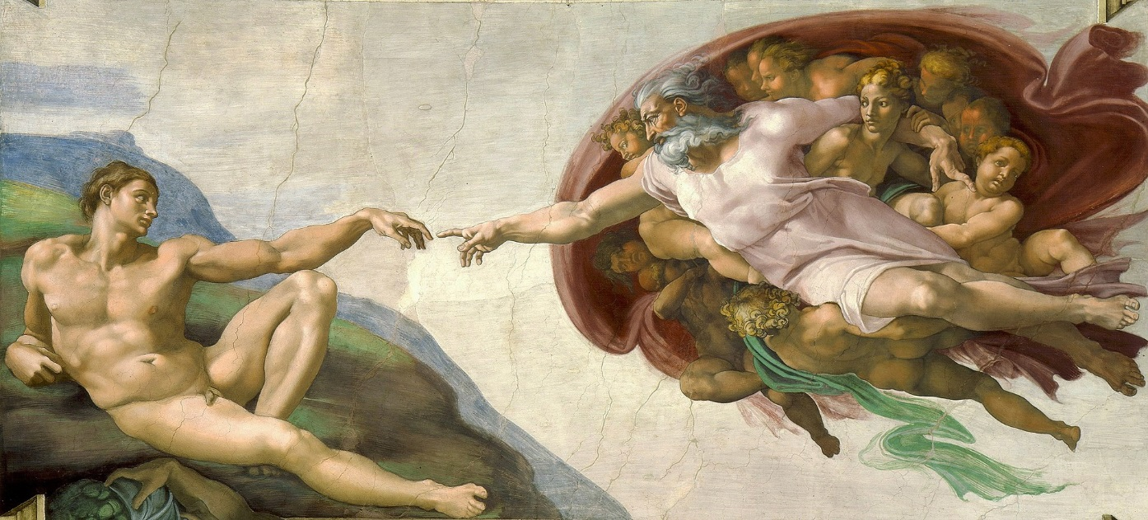
Evolution, Ecology & Faith: The Catholic Difference
Sister Damien Marie Savino, FSE, Ph.D.
Aquinas College, Grand Rapids, MI
dms002@aquinas.edu

Slide 2
Evolution, Ecology & Faith: The Catholic Difference
What is Evolution? What is Ecology?
As Catholic educators, why should we be concerned about this?
Some Potential Pitfalls
The “Catholic Difference”
An Opportunity for Catholic Education

Slide 3
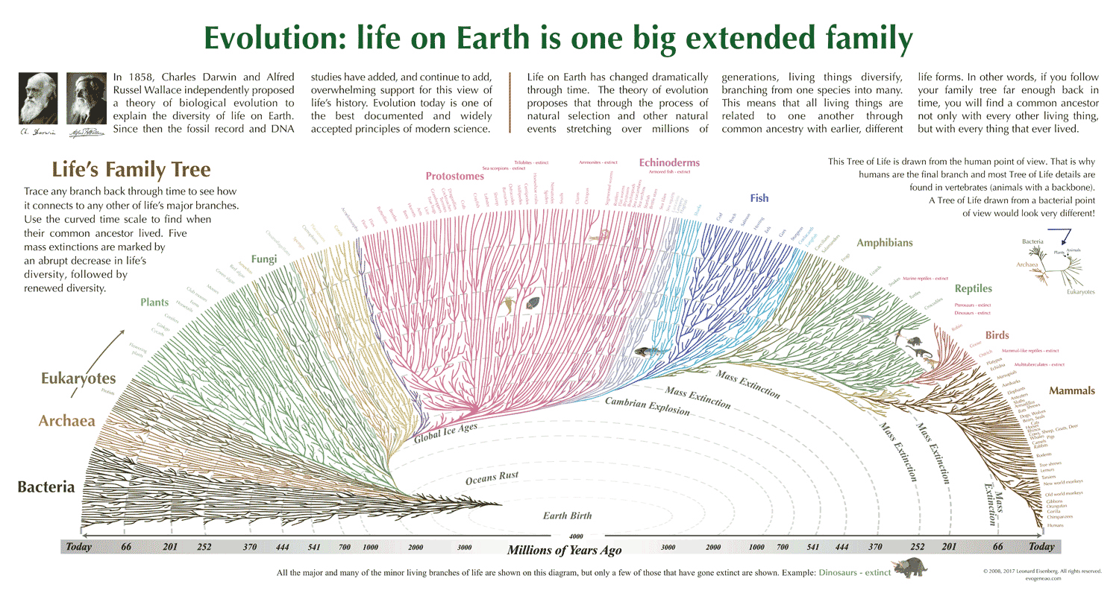
What is Evolution?

Slide 4
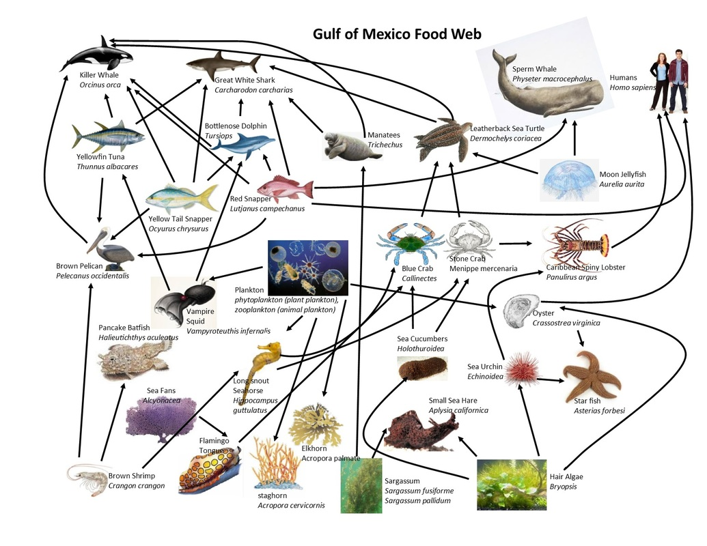
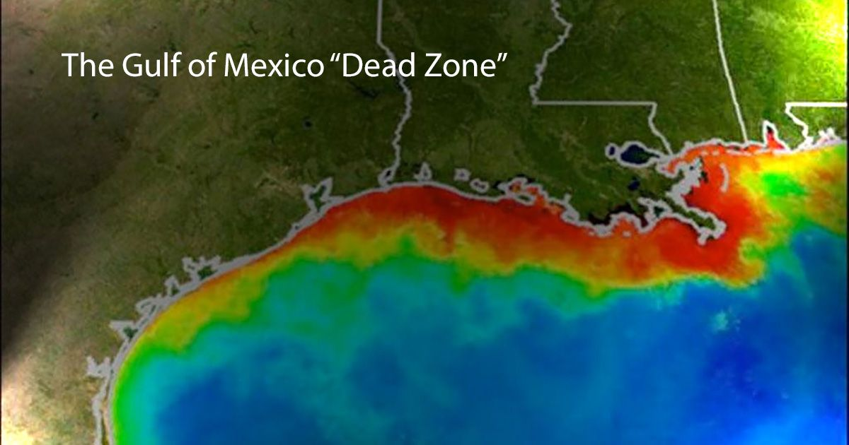
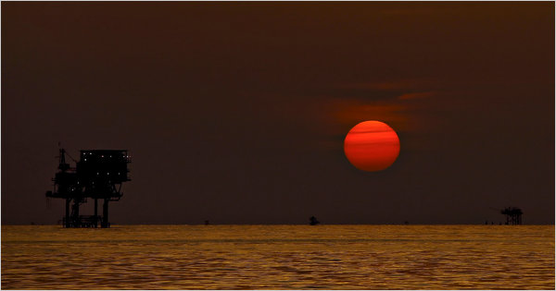
What is Ecology?
Notes:
/

Slide 5
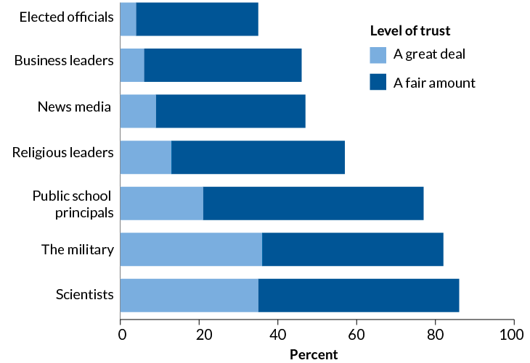
As Catholic Educators, Why Should We Be Concerned About This?
Evolution vs. God film
Which professionals do Americans trust most to act in the public interest?
Trust us
When it comes to overall confidence that professionals act in the public good, scientists scored the highest among respondents, followed closely by the military. Trust in the motivations of journalists and politicians trailed, by comparison.
Science News, August 31, 2019, p. 5
Source: Pew Research Center Survey 2019

Slide 6
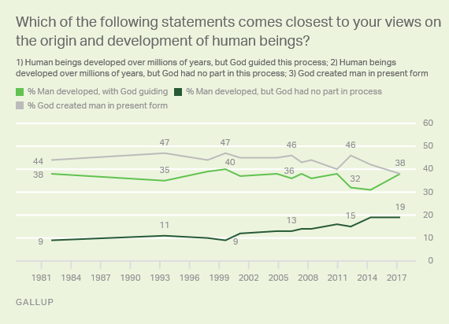
https://news.gallup.com/poll/210956/belief-creationist-view-humans-new-low.aspx

Slide 7
How Do We “Square” These Views?
Psalm 8 | Atheistic Materialism
. . . When I see your heavens, the work of your fingers, the moon and stars that you set in place— What is man that you are mindful of him, and a son of man that you care for him? Yet you have made him little less than a god, crowned him with glory and honor. You have given him rule over the works of your hands, put all things at his feet: All sheep and oxen, even the beasts of the field, The birds of the air, the fish of the sea, and whatever swims the paths of the seas. O LORD, our Lord, how awesome is your name through all the earth! | In a universe of electrons and selfish genes, blind physical forces and genetic replication, some people are going to get hurt, other people are going to get lucky, and you won't find any rhyme or reason in it, nor any justice. The universe we observe has precisely the properties we should expect if there is, at bottom, no design, no purpose, no evil, no good, nothing but blind, pitiless indifference. River Out of Eden: A Darwinian View of Life, Richard Dawkins

Slide 8
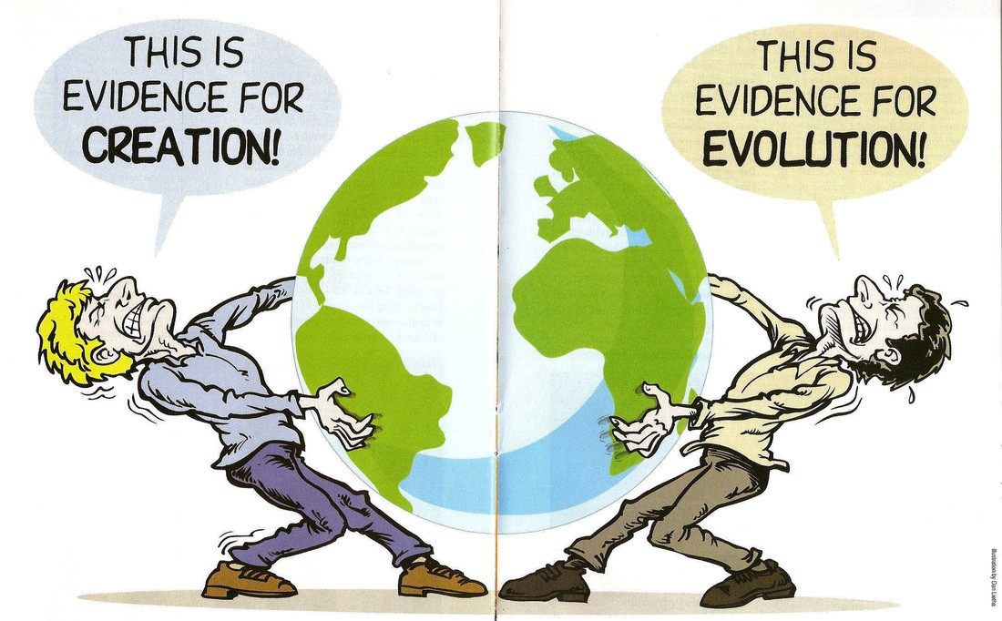
https://me.me/i/this-is-evidence-for-creation-this-is-evidence-for-evolution-22910752

Slide 9
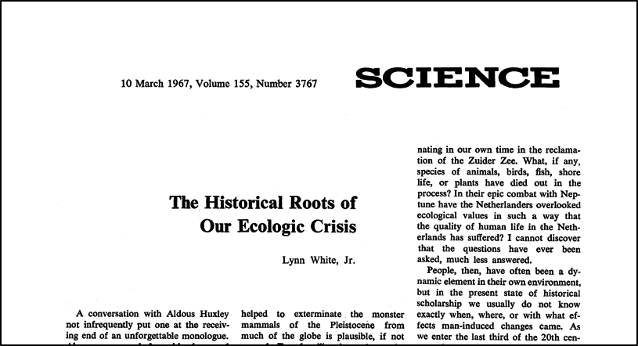
The Ecological Indictment of Christian Anthropocentrism
“Christianity is the most anthropocentric religion the world has seen. . . Christianity, in absolute contrast to ancient paganism and Asia's religions, not only established a dualism of man and nature but also insisted that it is God's will that man exploit nature for his proper ends. . . Christianity bears a huge burden of guilt [for the ecological crisis].
(Lynn White, “The Historical Roots of the Ecological Crisis,” 1967, Science 155: 1203-1207)

Slide 10
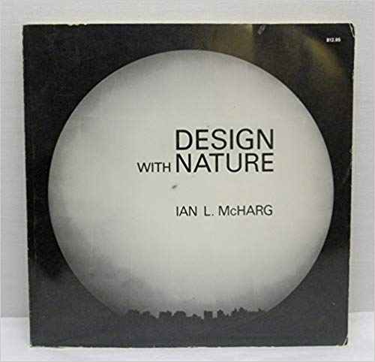
The Ecological Indictment of Christian Anthropocentrism
On the subject of man-nature, the Biblical creation story of the first chapter of Genesis, the source of the most generally accepted description of man’s roles and powers, . . . in its insistence upon domination and subjugation of nature, encourages the most exploitative and destructive instincts in man rather than those that are deferential and creative.”
(Ian McHarg, Design with Nature, 1969, p. 26)

Slide 11
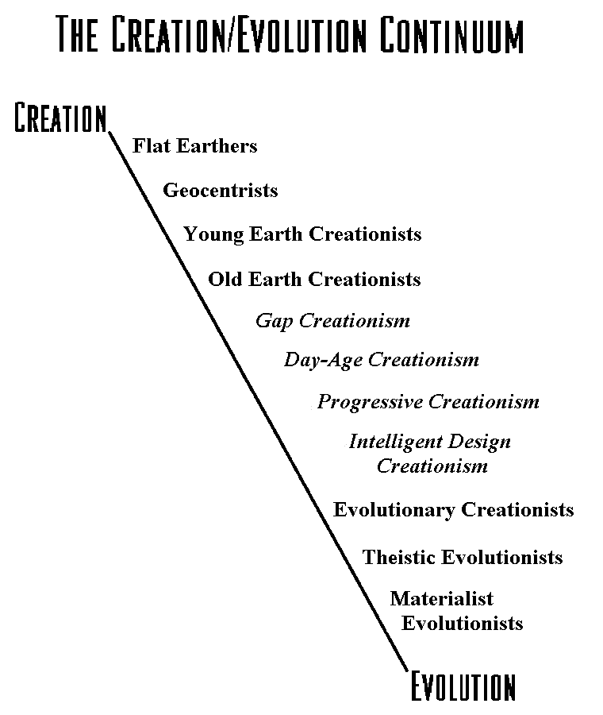
Seven Pitfalls
The Ideology of Material-ISM
The Question of Chance/Randomness
The Dual Problems of CreationISM and Intelligent Design-ISM
Evolution = the “Survival of the Fittest”
http://www.elabs.com/van/Scott_Continuum_Creationism-Evolution.htm

Slide 12
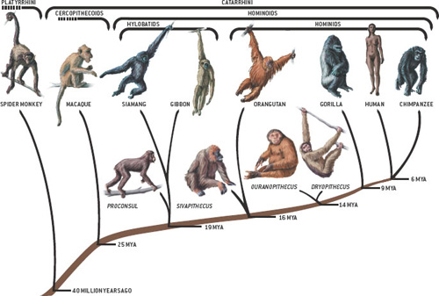
Pitfall 5: The Challenge of Hominization

Slide 13
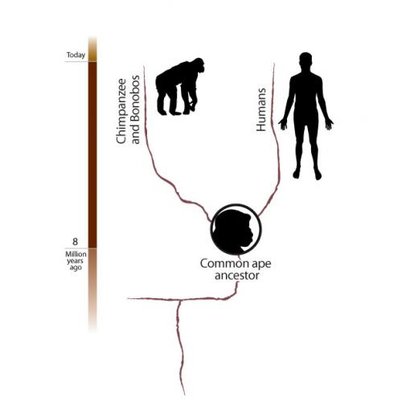
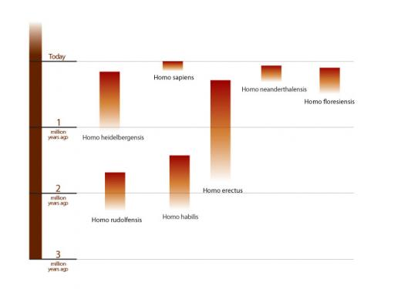
Pitfall 5: The Challenge of Hominization
Smithsonian Institution, “What Does It Mean to Be Human,” http://humanorigins.si.edu/education/frequently-asked-questions

Slide 14
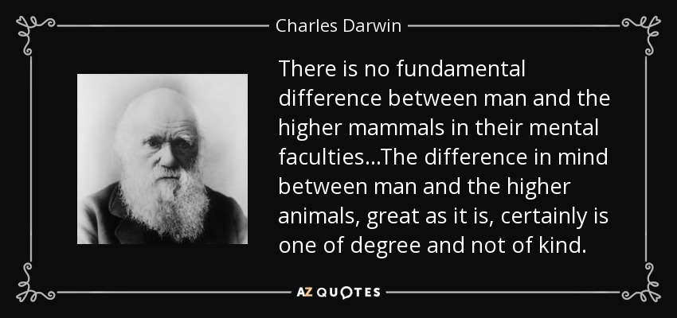
Pitfall 6: “Difference in Degree” vs. “Difference in Kind”

Slide 15
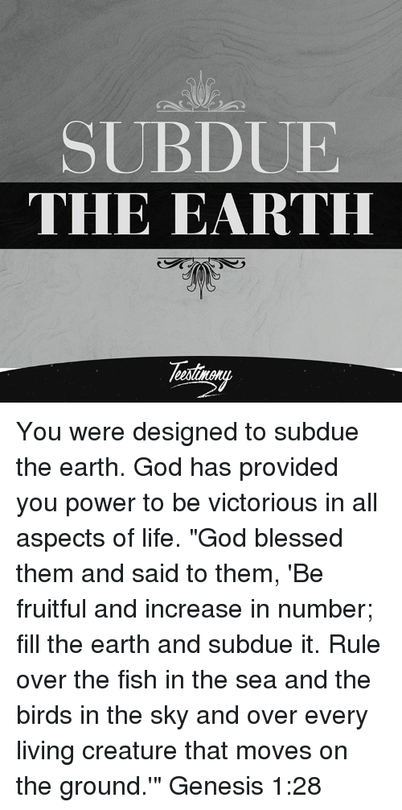
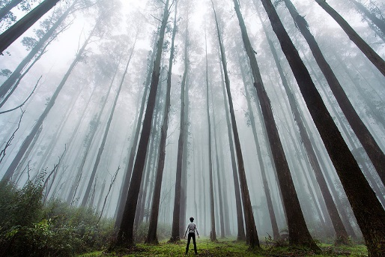
Pitfall 7: Anthropocentrism vs. Biocentrism
False dilemma between the primacy of the person & the primacy of nature
“This situation has led to a constant schizophrenia, wherein a technocracy which sees no intrinsic value in lesser beings coexists with the other extreme, which sees no special value in human beings.”(LS 118)

Slide 16
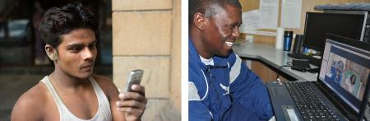
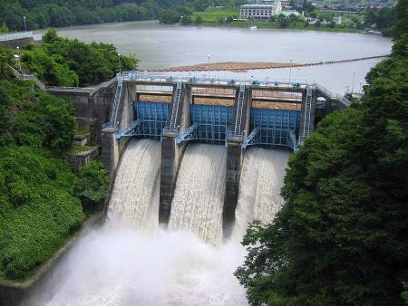
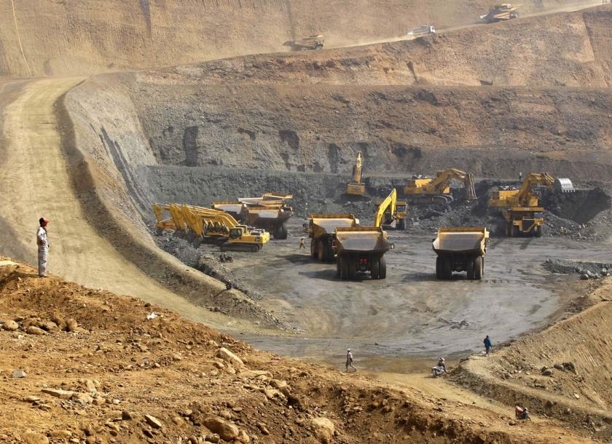
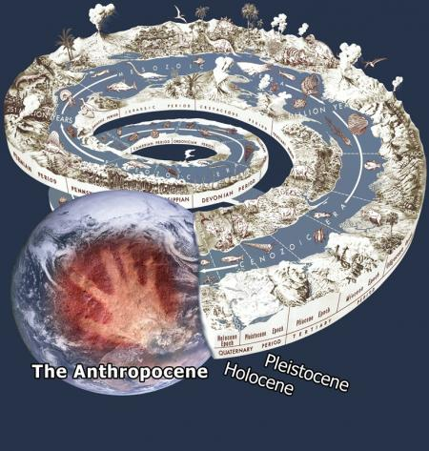
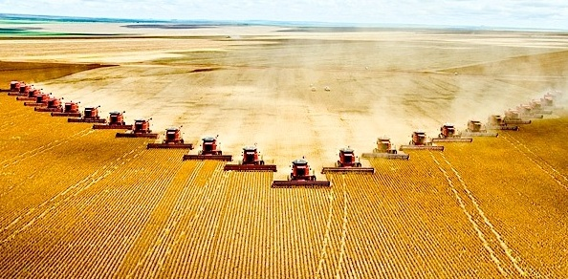
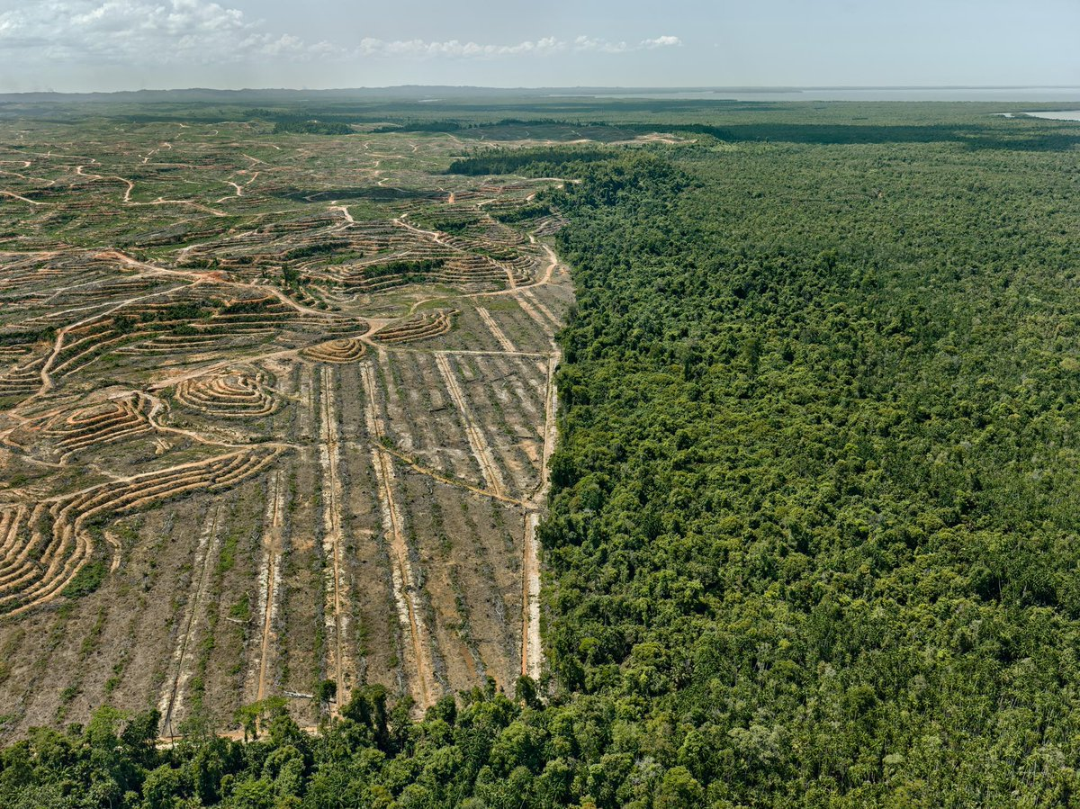
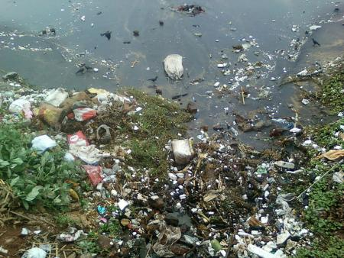
Human “Schizophrenia” Humans as dominators

Slide 17
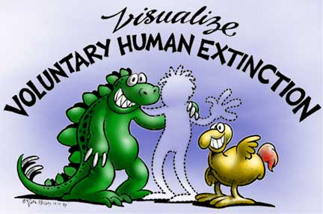
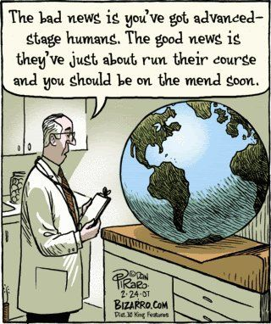

Human “Schizophrenia” Humans As Disease of Nature
To Save the Planet, Kill 90 Percent of People Off, Says UT Ecologist
Nature Is Losing The Battle Against Humans

Slide 18
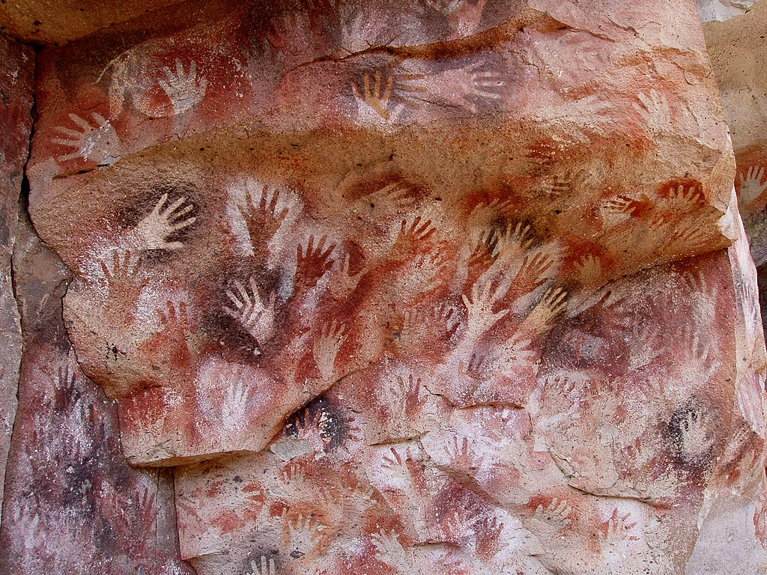
A Middle Way: The Catholic Difference
“Both-And”
Creation AND Evolution
Primary AND Secondary Causality
Difference in Degree AND Difference in Kind
Body AND Soul
Respect of Human Persons AND Nature
Hands at the Cuevas de las Manos upon Río Pinturas, in Argentina. Est. 13,000 – 9,000 bp
By Mariano - Own work, CC BY-SA 3.0, https://commons.wikimedia.org/w/index.php?curid=265811

Slide 19
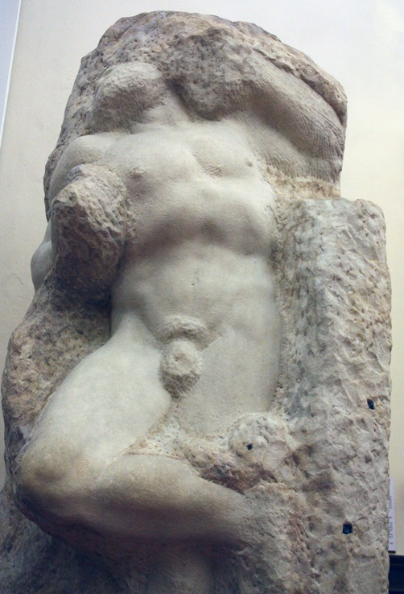
A Middle Way: The Catholic Difference #6
The Awakening Slave, Michelangelo (1520)
“There can be no ecology without an adequate anthropology.” (LS 118)
“We become fully human when we become more than human, when we let God bring us beyond ourselves in order to attain the fullest truth of our being.”
Pope Francis, Evangelium Gaudium #8

Slide 20
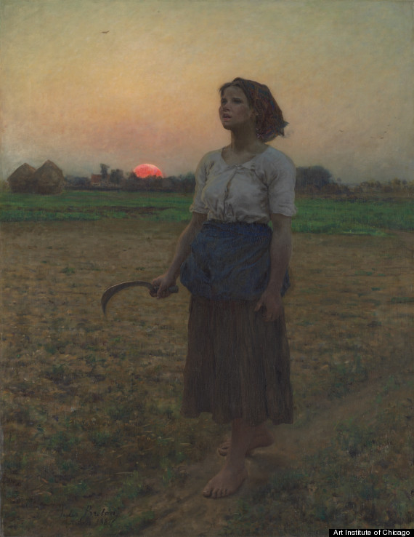
A Middle Way: The Catholic Difference #7
New Image for Humans:
Humans as Gardeners
The Song of the Lark, Jules Adolphe Breton (1884)

Slide 21
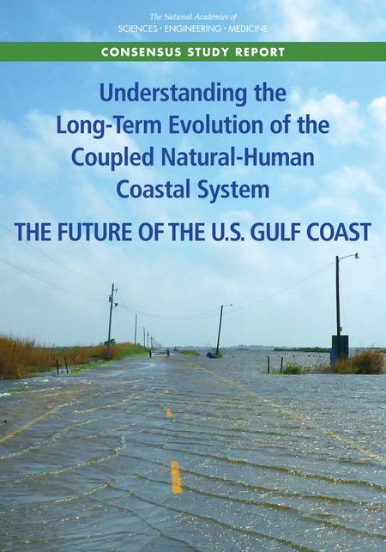
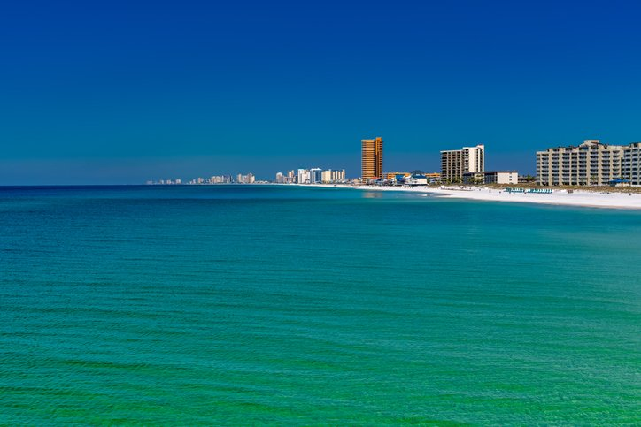
An Opportunity for Catholic Education
Teaching Evolution and Ecology as Instruments of the New Evangelization
What does it mean to be a human person?
What is my call and vocation in the created world?

Slide 22
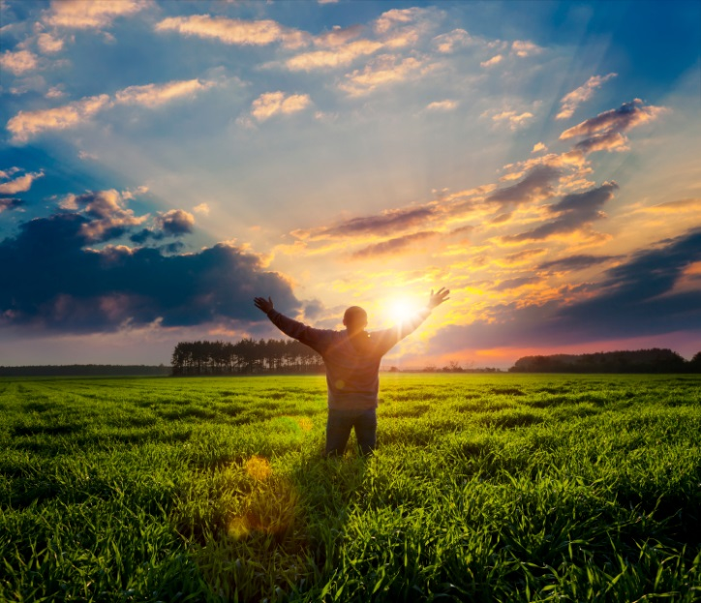
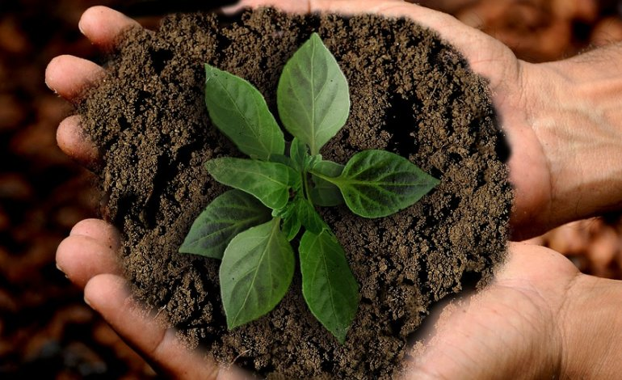
An Opportunity for Catholic Education
Whenever nature, and human beings in particular, are seen merely as products of chance or an evolutionary determinism, our overall sense of responsibility wanes. On the other hand, seeing creation as God’s gift to humanity helps us understand our vocation and worth as human beings.
With the Psalmist, we can exclaim with wonder: “When I look at your heavens, the work of your hands, the moon and the stars which you have established; what is man that you are mindful of him, and the son of man that you care for him?” (Ps 8:4-5).
(Pope Benedict XVI, World Day of Peace message: “If you want to cultivate peace, protect creation,” January 1, 2010)

Slide 23
Helpful Resources
Christopher Baglow, Faith, Science and Reason: Theology on the Cutting Edge (2019, 2nd edition)
Sister Damien Marie Savino, FSE & John Hittinger, “Loss of Creation and Its Recovery Through Aquinas and Bonaventure,” New Blackfriars (2015). dms002@aquinas.edu
Sister Damien Marie Savino, FSE, “Atheistic Science: The Only Option?” Logos: Journal of Catholic Thought and Culture (2009).
Nicanor Austriaco, O.P., et.al., Thomistic Evolution: A Catholic Approach to Understanding Evolution in the Light of Faith (2016).
Stacy Trasancos, Particles of Faith: A Catholic Guide to Navigating Science (2016)
Stephen Barr, Modern Physics and Ancient Faith (2003).
Smithsonian Institution, “What Does It Mean to Be Human,” http://humanorigins.si.edu/.
University of California-Berkeley, “Understanding Evolution,” https://evolution.berkeley.edu/evolibrary/home.php.

